Slide 1
Introduction to Container Services on
Alibaba Cloud

Slide 2

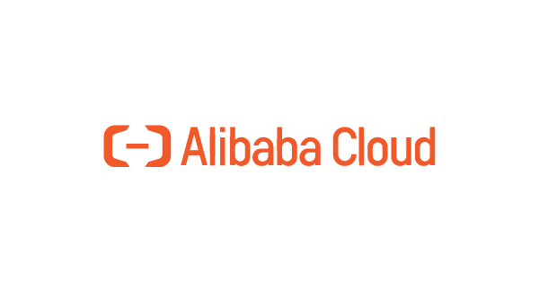





What do we Have for Container Services
What’s New on ACK/ACR
Case Studies and Scenarios

Slide 3
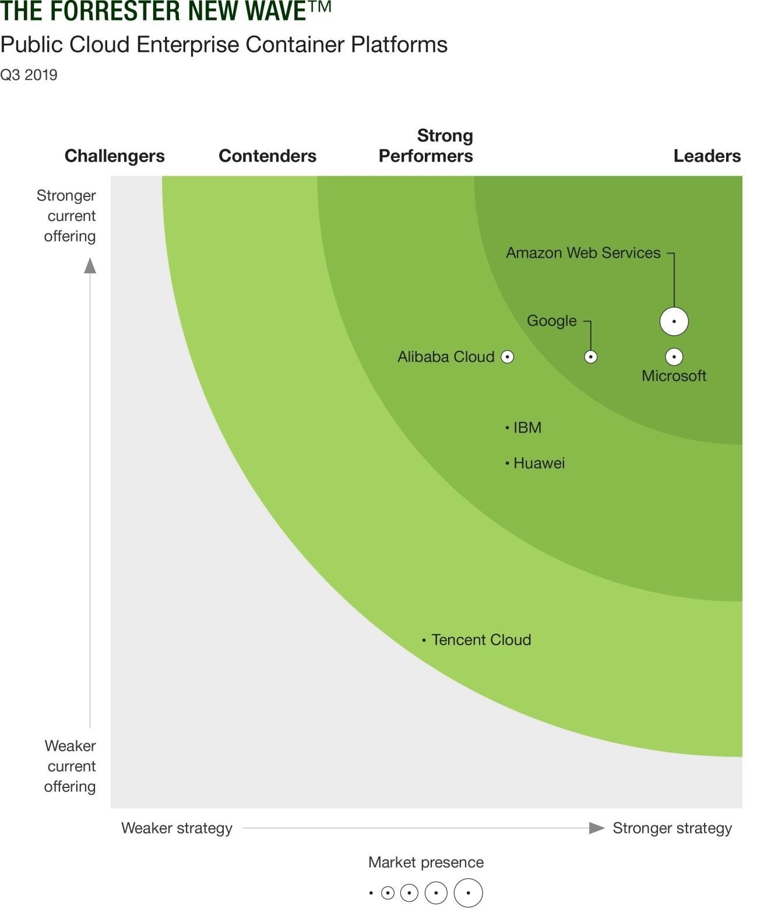
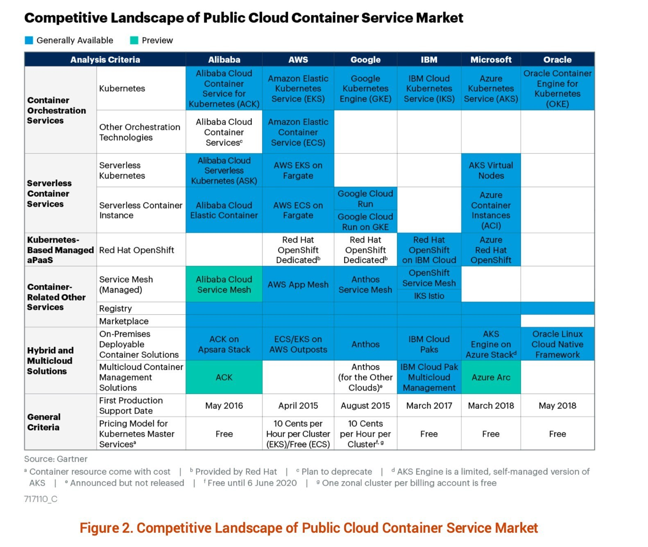



Global Leading Container Service
 | Alibaba Cloud | AWS | Azure | GCP | Oracle
Required and Preferred
Customizable container orchestration service | Yes | Yes | Yes | Yes | Yes
Rapid provisioning of container instances | Yes | No | Yes | No | No
Simplified container orchestration service | Yes | Yes | Yes | Yes | No
Kubernetes service | Yes | Yes | Yes | Yes | Yes
Private container registry | Yes | No | No | Yes | No
Optional
Windows container support | Yes | Yes | Yes | Yes | No
Service mesh | Yes | Yes | No | Yes | No
In the third quarter of 2019, Alibaba Cloud was ranked first in China in the report on public cloud enterprise container services released by Forrester.
Alibaba Cloud is the only Chinese cloud service provider selected by Gartner as part of the competitive landscape of the public cloud container service market for two consecutive years.
Alibaba Cloud is the only cloud service provider in the world to satisfy all the criteria of container services in The 2020 Gartner Magic Quadrant for Cloud Infrastructure and Platform Services.

Slide 4



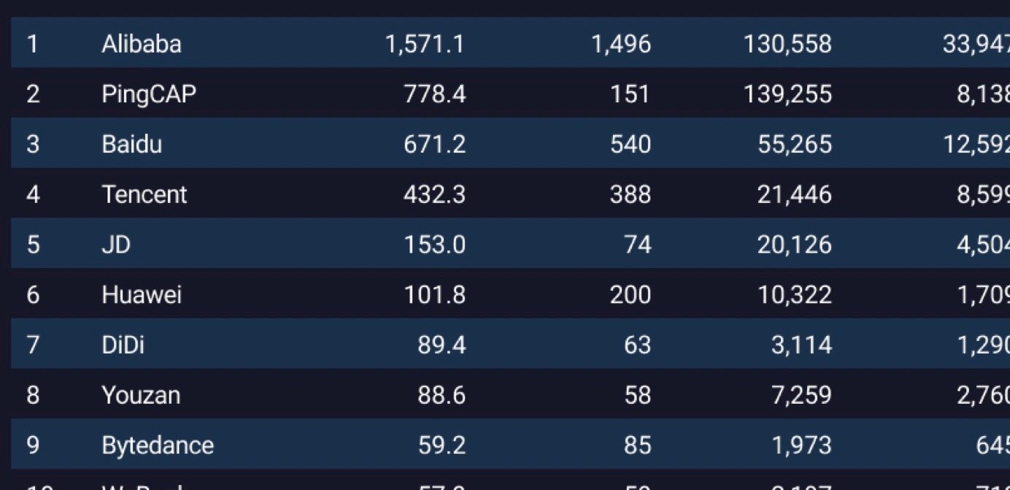
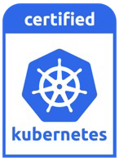
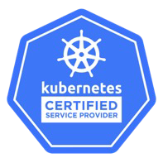
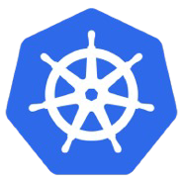






Embrace Open Source Cloud Native Community
Alibaba’s open-source projects are the most active among Chinese enterprises – GitHub 2020 Digital Insight Report
Platinum Member
Lei Zhang is TOC member
General member Wei Fu is TOC member
General Member
Certified Kubernetes Platform Kubernetes Certified Service Provider
Many contributions in community
2600+
Projects in GitHub
Millions of stars in total
Lei Zhang
CNCF TOC
Wei Fu
Open Container Initiative
TOB
Xu Yang
Architecture Committee Member of KataContainer
Jian Fang
Spring Cloud Alibaba Architect
Jun Liu
Apache Dubbo PMC
4

Slide 5















Container Infrastructure for World Wide Customers
14000+ Customers , 50+ Verticals around the World
200%+ 2B+ 9X
24
22%
Regions
And 3 regions for Financial Cloud,
1 region for Gov Cloud.
Revenue Growth YoY
Image Pulls Per Month
Usage growth for Serverless Container over 2019
Edge Computing nodes among total
Germany
London
China Mainland
US West
US East
Japan
UAE
India
Hong Kong
Malaysia
Indonesia
Singapore
Alibaba Group – One of the largest cloud native deployments in the world
Over 90% Applications running on ACK (including Databases, CDN, etc.) 10K node+ in a single cluster, 3M+ pods in total
Australia
6

Slide 6











Alibaba Cloud Container Service Portfolio
Microservices
Stateful Apps
Big Data and AI
Innovation
Any workload
Apache Dubbo
Spring Cloud
MySQL
RocketMQ
Apache Flink
TensorFlow
Blockchain
IoT
Application Lifecycle Management
ASM
Service Mesh
Auto-scaling
Workload Automation
GitOps
Disaster Recovery
Cluster Lifecycle Management
Hybrid/Multi-cloud
Management
Security Governance
Cost Analysis
Observerability
Auto-healing/Autonomy
ACR
Container Registry
Cloud native OS
ACK – Kubernetes Service
ASK - Serverless Kubernetes Service
ECI – Elastic Container Instance
ACK@Edge – Kubernetes for Edge/IoT
Apsara Stack Apsara Stack Agility/AECP
on-premise
Kubernetes Cluster
Hardware Accelerator
High Performance Network
Comprehensive Storage
Enhanced Scheduler
Container Runtime
Any architecture
(X86/ARM, Linux/Windows)
Linux Container
Windows Container
Alibaba Sandbox Container
Enclave Container
Any location
Public Cloud
Local Region
Edge Nodes
IoT Devices
On-Premise
Or Cloud Box

Slide 7
Deployment Modes for Kubernetes Service
Dedicated Kubernetes
Managed Kubernetes
Serverless Kubernetes
Master Nodes
Owned by user and customizable
Managed by Alibaba Cloud
Multitenant and managed by Alibaba Cloud
Worker Nodes
Owned by user
Owned by user
Nodeless
K8s version
Selectable and upgradable
Selectable and upgradable
N/A (automatic upgrading)
Multi-AZ High Availability
Master nodes: Configurable by user
Worker nodes: Configurable by user
Master nodes: Yes by default
Worker nodes: Configurable by user
Control plane: Yes by default
Pods: Configurable by user
Cost Model
Kubernetes service is free, pay for underneath resources
Kubernetes service is free, pay for underneath resources
Kubernetes service is free, pay for resources allocated for applications
Capacity Planning
Required and support auto scaling
Required and support auto scaling
Not required
Scenarios
All scenarios for enterprise customers
All scenarios
Optimized for burst workload,
e.g. batch processing, CI/CD tasks

Slide 8




Differentiations of Kubernetes Cluster
Managed/Dedicated K8s
Serverless K8s
Pay for infrastructure Node maintenance required Capacity planning required
Pay for workload
Node maintenance NOT required Autoscaling on demand
Container Scheduling and Orchestration
Container Scheduling and Orchestration
Elastic Container Instance
ECS
ECS
ECS
ECI
POD POD
POD POD
POD POD
POD POD POD POD POD POD POD POD
POD POD
POD POD
POD POD
POD POD POD POD POD POD POD POD
ECS, EBS(ECS Bare Metal), simplify scale up to ECI
Cloud bursting, Large scale batch processing, Hybrid elasticity
Spot instance and GPU, NPU, FPGA are supported
Simplify autoscaling for traffic busting
Data processing, Presto, Spark, Speed up CI/CD pipeline,
Jenkins, Gitlab-runner etc.
Spot instance and GPU are supported

Slide 9



Container Registry Service (ACR) Enterprise Edition
Cloud-Native Artifact
E2E
Security
Optimized Distribution
Global Replication
Manage both container images and Helm charts v2/v3
VPC intranet supported
User-defined domain and network ACL
P2P based large scale image distribution over than 10K nodes
Speed up image pulling to 1 sec through snapshot
Policy based image replication across different regions.
Replication efficiency improved 7 fold.
Server-side encryption for storage
Vulnerability scan and analysis
Content trust
SLA 99.95%

Slide 10
What do we Have for Container Services
What’s New on ACK/ACR
Case Studies and Scenarios

Slide 11



Cloud-Native Application Transformation
HPA
VPA
Cron HPA
Auto Scale
(According to telemetry and metrics dat
Pod
Pod
Pod
a
Pod
Pod
Pod
Pod
auto scale)
Pod
Pod
Pod
Pod
Pod
Pod
DevOps (CI/CD)
ACK
（Container Service for Kubernetes）
ASK
(Serverless Kubernetes Service)
ACR
(Container Registry)
Computing ECS, EBM, GPU, FPGA, ECI | Network VPC, ENI, SLB, DNS, RDMA | Storage EBS, NAS, CPFS, OSS

Slide 12
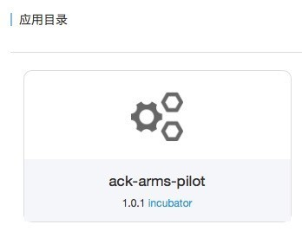
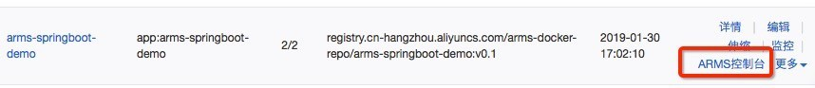
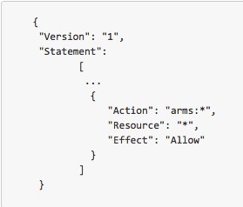
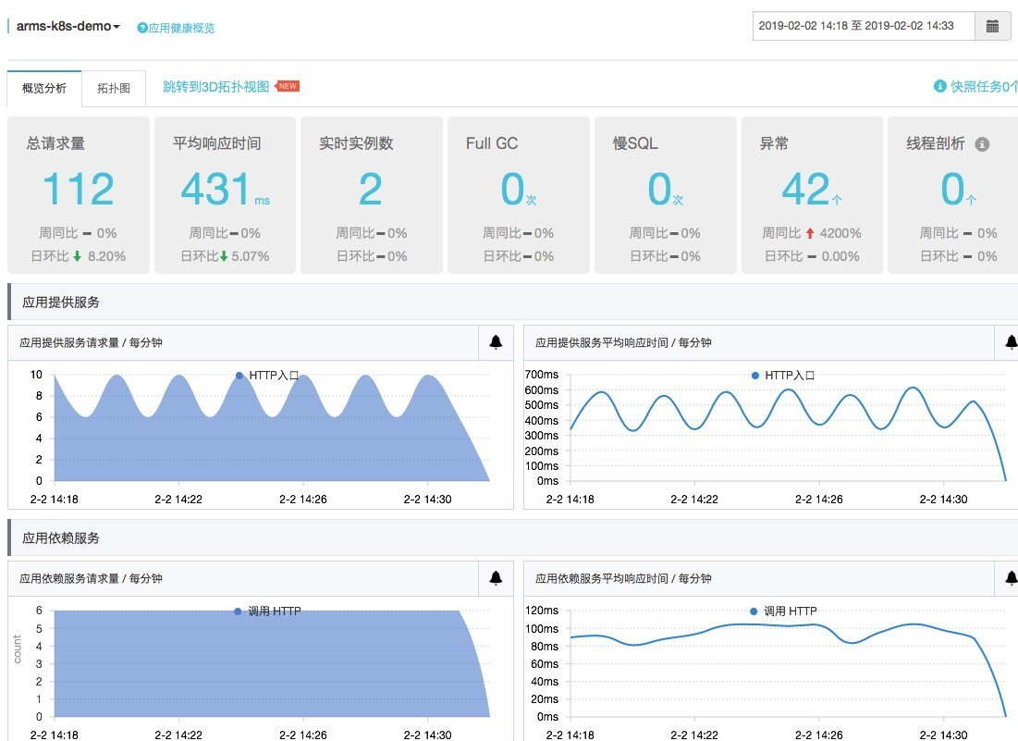
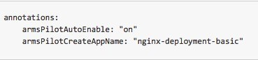
Monitoring Management: Fast & Non-Intrusive Integration with ARMS (Java)
1
Deploy arms pilot to Helm/chart
From the container page to the ARMS page
2
Modify RAM authorization (to be automated)
3
Simply annotate the application container to enable automatic integration
Collect Data
4
* Prerequisite: ARMS is activated

Slide 13






























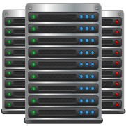










ACK@Edge -- Cloud Native Kubernetes Platform for the Edge
Solutions and Ecosystems
Internet of
New
Industrial Brain
City Brain
Things
Edge AI
Hybrid clouds
Network Channels with Cloud-edge Collaboration
SAG 2.0
Edge Computing Scalability
Cloud-edge Integrated O&M
Multi-pipeline Hot Backup for Hardware and Software
IPsec Encryption
Nationwide and Worldwide Nearby Access
Low Cost and High Efficiency
Cloud
ACK@Edge
Edge Computing Power Scheduling and Sharing
Hybrid Resource Management
Security
Center
AHAS
Low Costs
CCN + CEN
Edge Tunnel-Server
Pipe
Multi-pipeline Hot Backup, IPsec Encryption Nationwide and Worldwide Nearby Access
Internet
SAG
Virtual Private Cloud (VPC)
New Cell-based Application Management
VSAG
Edge Tunnel-Agent
Cell-based Management at the Edge
Cell-based Traffic Management
Cell-based Application Deployment
Edge
Device Edge
E.g. Examples: factories, parks, buildings, airports, and gateways
Security
Center
AHAS
Infrastructure Edge
E.g. CDN, ENS
EdgeUnit-2
EdgeUnit-2
Edge Unit
Edge Autonomy
Support for Heterogeneous Resources
Lightweight
Canary Release of Edge Nodes
Sandboxed Container
Based on

Slide 14
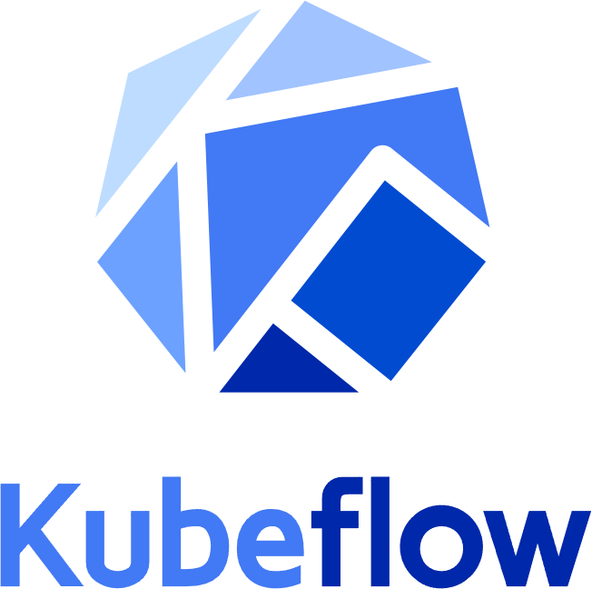
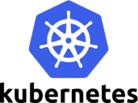
AI Workloads Moving to Containers
By 2023, 70% of AI workloads will use application containers or be built using a serverless programming model necessitating a DevOps culture. - Gartner
Benefits:
Scalability
Portability
Composability
ML Stages
Model
UX
Tooling
Data Ingestion
Data Analysis
Data Transformation
Data Validation
Data Splitting
Framework
Storage
Challenges:
Data Splitting
Building a Model
Model Validation
Training At Scale
Runtime
Large scale heterogeneous resources management
Drivers
Low GPU utilization
Monitoring Logging
Roll-out
Serving
OS
High latency for distributed training
Accelerator
HW

Slide 15



Cloud Native AI Acceleration Overview
Provides a set of essential features and services to help clients to build their own AI/Big data platform, accelerate AI/Big data workloads and simplify MLOps/DataOps
Alibaba Cloud AI/Big Data services on ACK
Customer owned AI/Big Data platform on ACK
GPU
utilization increased 100%
Productivity improved 50%
AI training speed up 20%
PAI
EMR
Flink
DLA
Dataworks
Elastic Job
MLOps/DataOps
Elastic AI Training
Elastic AI Inference
Elastic Data Processing
Pipeline
Kubeflow
Data Acceleration
Enhance K8s for cloud native AI/Big data
Elastic Dataset - Fluid
Distributed Data Cache – Jindofs/Alluxio
Auto scaling
Monitoring
Integrated hardware and software optimization of AI/Big data applications scale, performance and cost
Job Scheduler
GPU sharing Topology aware
Resource Management
GPU/NPU OSS/HDFS/CPFS
Batch
Quota
Data aware
Logging
Multi-tena ncy
Security
Full lifecycle support for AI/Big data workloads with Composable, extensible, modularized architecture
CPU
RDMA
Alibaba Cloud Container Service for Kubernetes
Public Cloud
Private Cloud
Edge Computing

Slide 16
What do we Have for Container Services
What’s New on ACK/ACR
Case Studies and Scenarios

Slide 17













Application Transformation
ACR
ACK Cluster
webhook
Preview
+
Alibaba Cloud Toolkit
Dockerfile
push
build
webhook
Source Code Repository
ACK Cluster
CI/CD
DevOps (CI/CD)
ACK ASK ^{ACR}
（Container Service for Kubernetes） (Serverless Kubernetes Service) ^{(Container}
Registry)
Comp St ge
ECS, EBM EBS, NAS, CPFS, OSS
Staging
pull
Source Code
Derrick
ACK Cluster
https://github.com/alibaba/derrick
Generated containerized artifacts from source code
Production

Slide 18






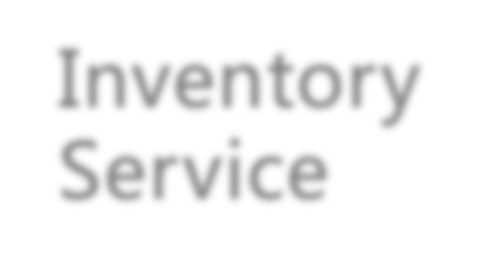
















Architecture Case 1
Redis
WebApp
APP
Micro-service
Pricing Service
Inventory Service
Order Service
Membership Service
…
RDS(MySQL)
POLARDB
OSS
AnalyticDB

Slide 19










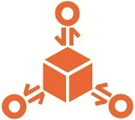
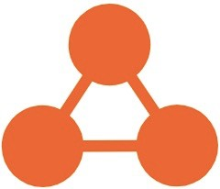


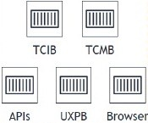
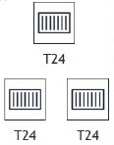









Architecture Case 2
Alibaba Cloud
WAF
Anti-DDos
SSL
Certificates Service
Secrets Manager
ACR
(&RQWDLQHU 5HJLVWU\)
OSS
Observability
Endpoint
Endpoint
Endpoint
LogService
ARMS-Prometheus
ACK(FRQWDLQHU VHUYLFH)
ACK/ASK
Users
API Gateway
Endpoint
SLB
ApsaraDB RDS (PostgreSQL)
VPC
Cloud Monitor
ARMS-Tracing
CEN
MQ
Branch Users
VPN
Gateway
VPC
AHAS
Function Compute
ApsaraDB for MongoDB
Function Compute
LogService

